Slide 1
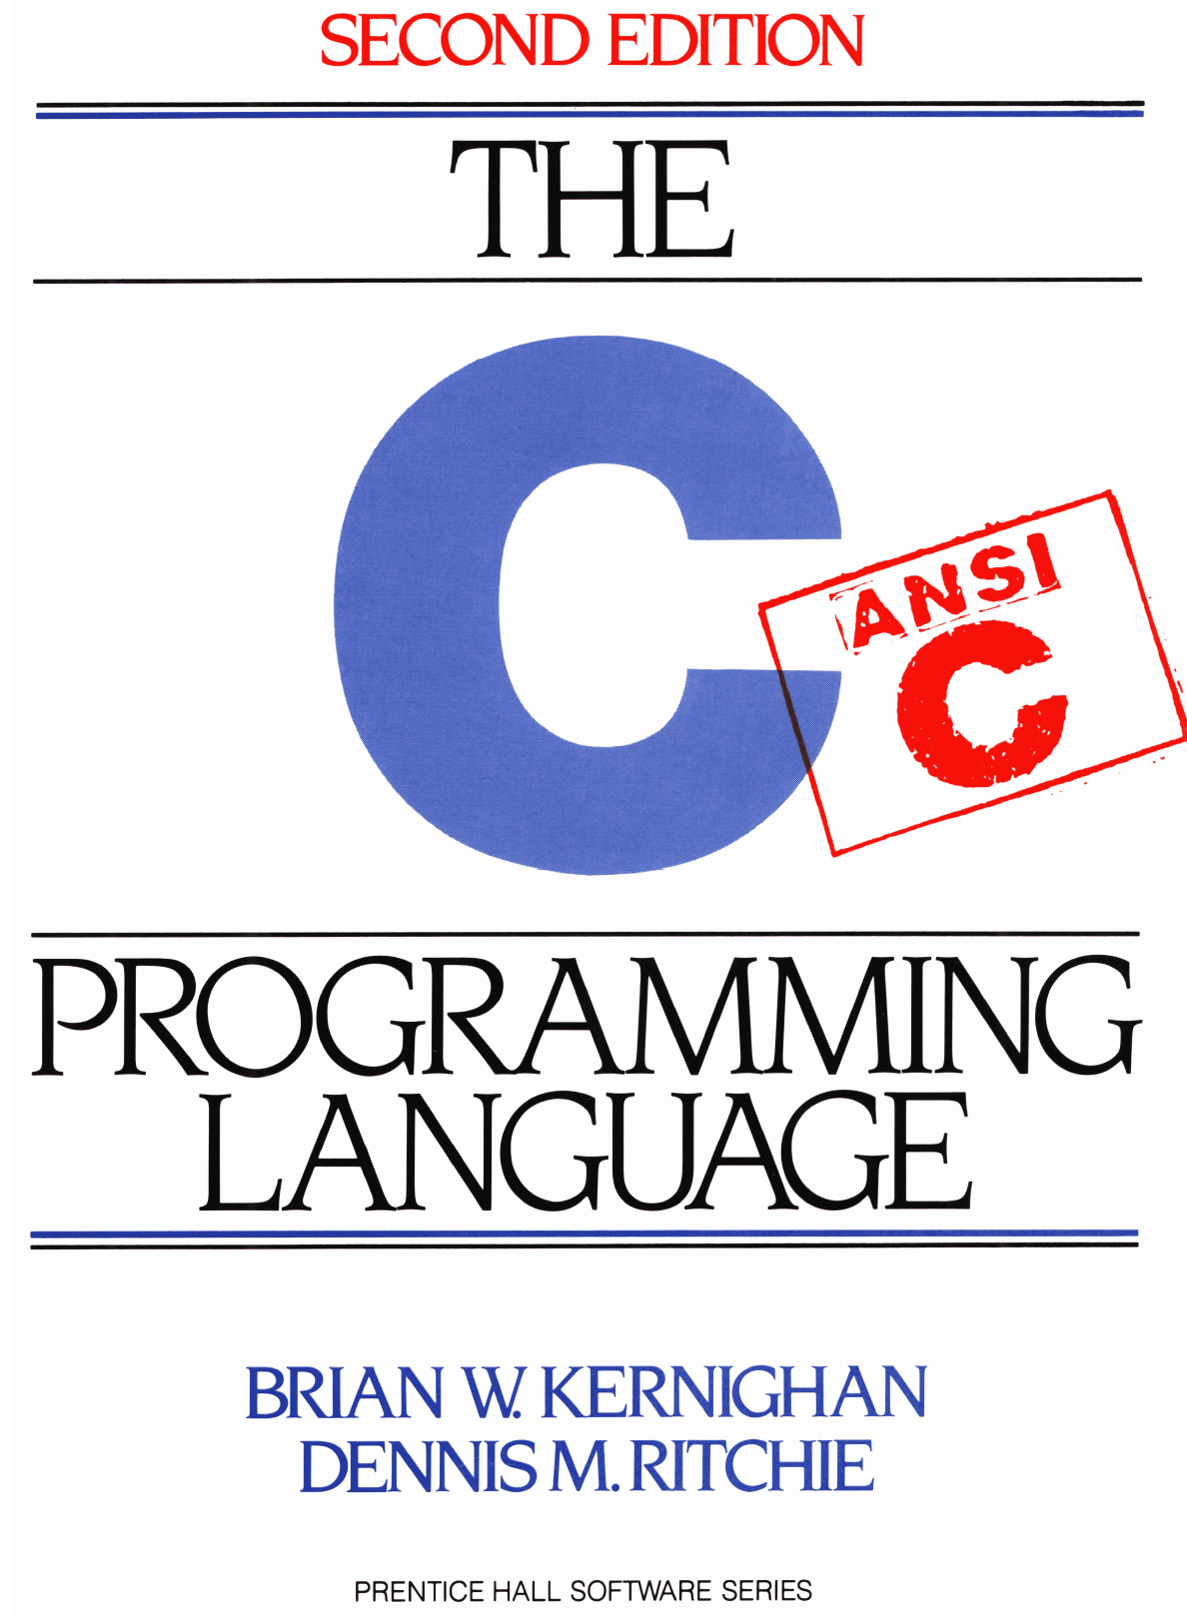
Chapter 7: Input and Output Kianoosh G. Boroojeni

Slide 2
Chapter Goals
To learn how to handle input streams in C
To learn how to handle input streams in C
To learn how to handle I/O exceptions in C

Slide 3
Standard Input and Output
int getchar (void): reads from standard input stream (usually keyboard)
Using “<“ for input redirection:
gcc test.c
./a.out <inputfile.txt
program reads characters from inputfile.txt instead of standard input
“<inputfile.txt” is not included in command-line arguments argv.

Slide 4
Standard Input and Output
Another approach: following command-line runs two programs p1 and p2:
p1 | p2
It pipes the standard output of p1 into standard input for p2
int putchar (int): puts the input character on the standard output.
Output stream redirection using command-line:
gcc test.c
./a.out >outputfile.txt
Redirecting both input and output streams
./a.out <inputfile.txt >outputfile.txt

Slide 5
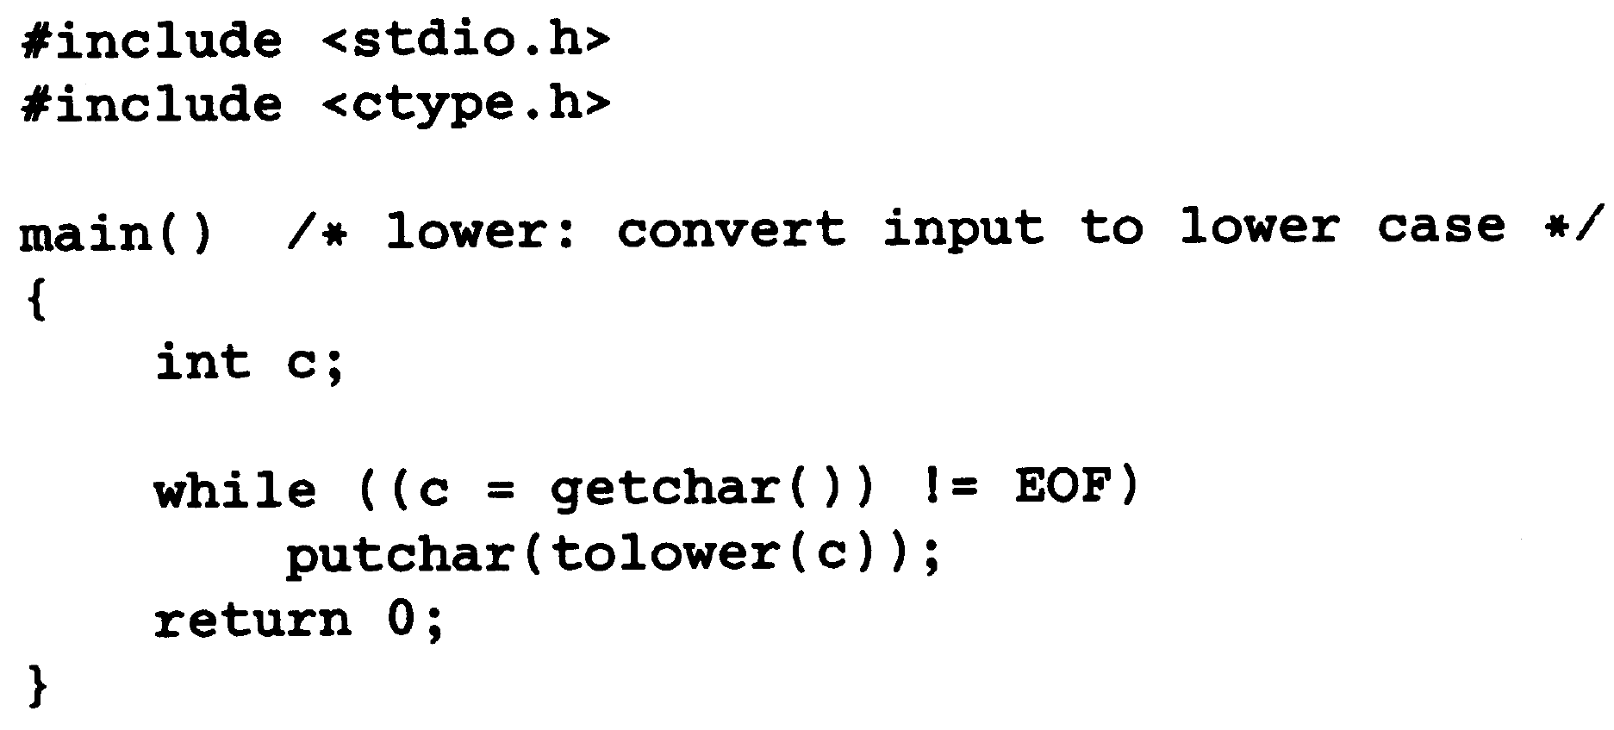
Example:

Slide 6
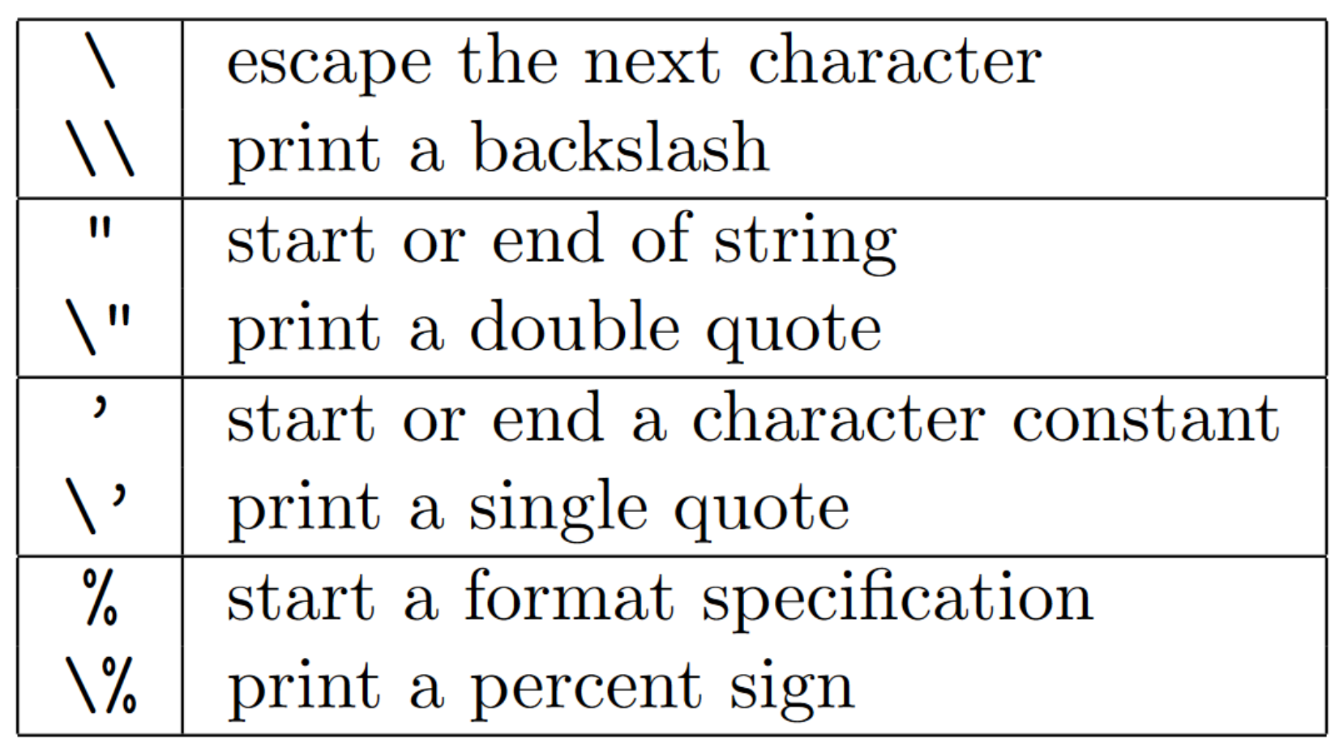
Formatted Output - printf
int printf (char * format, arg1, arg2,…)

Slide 7
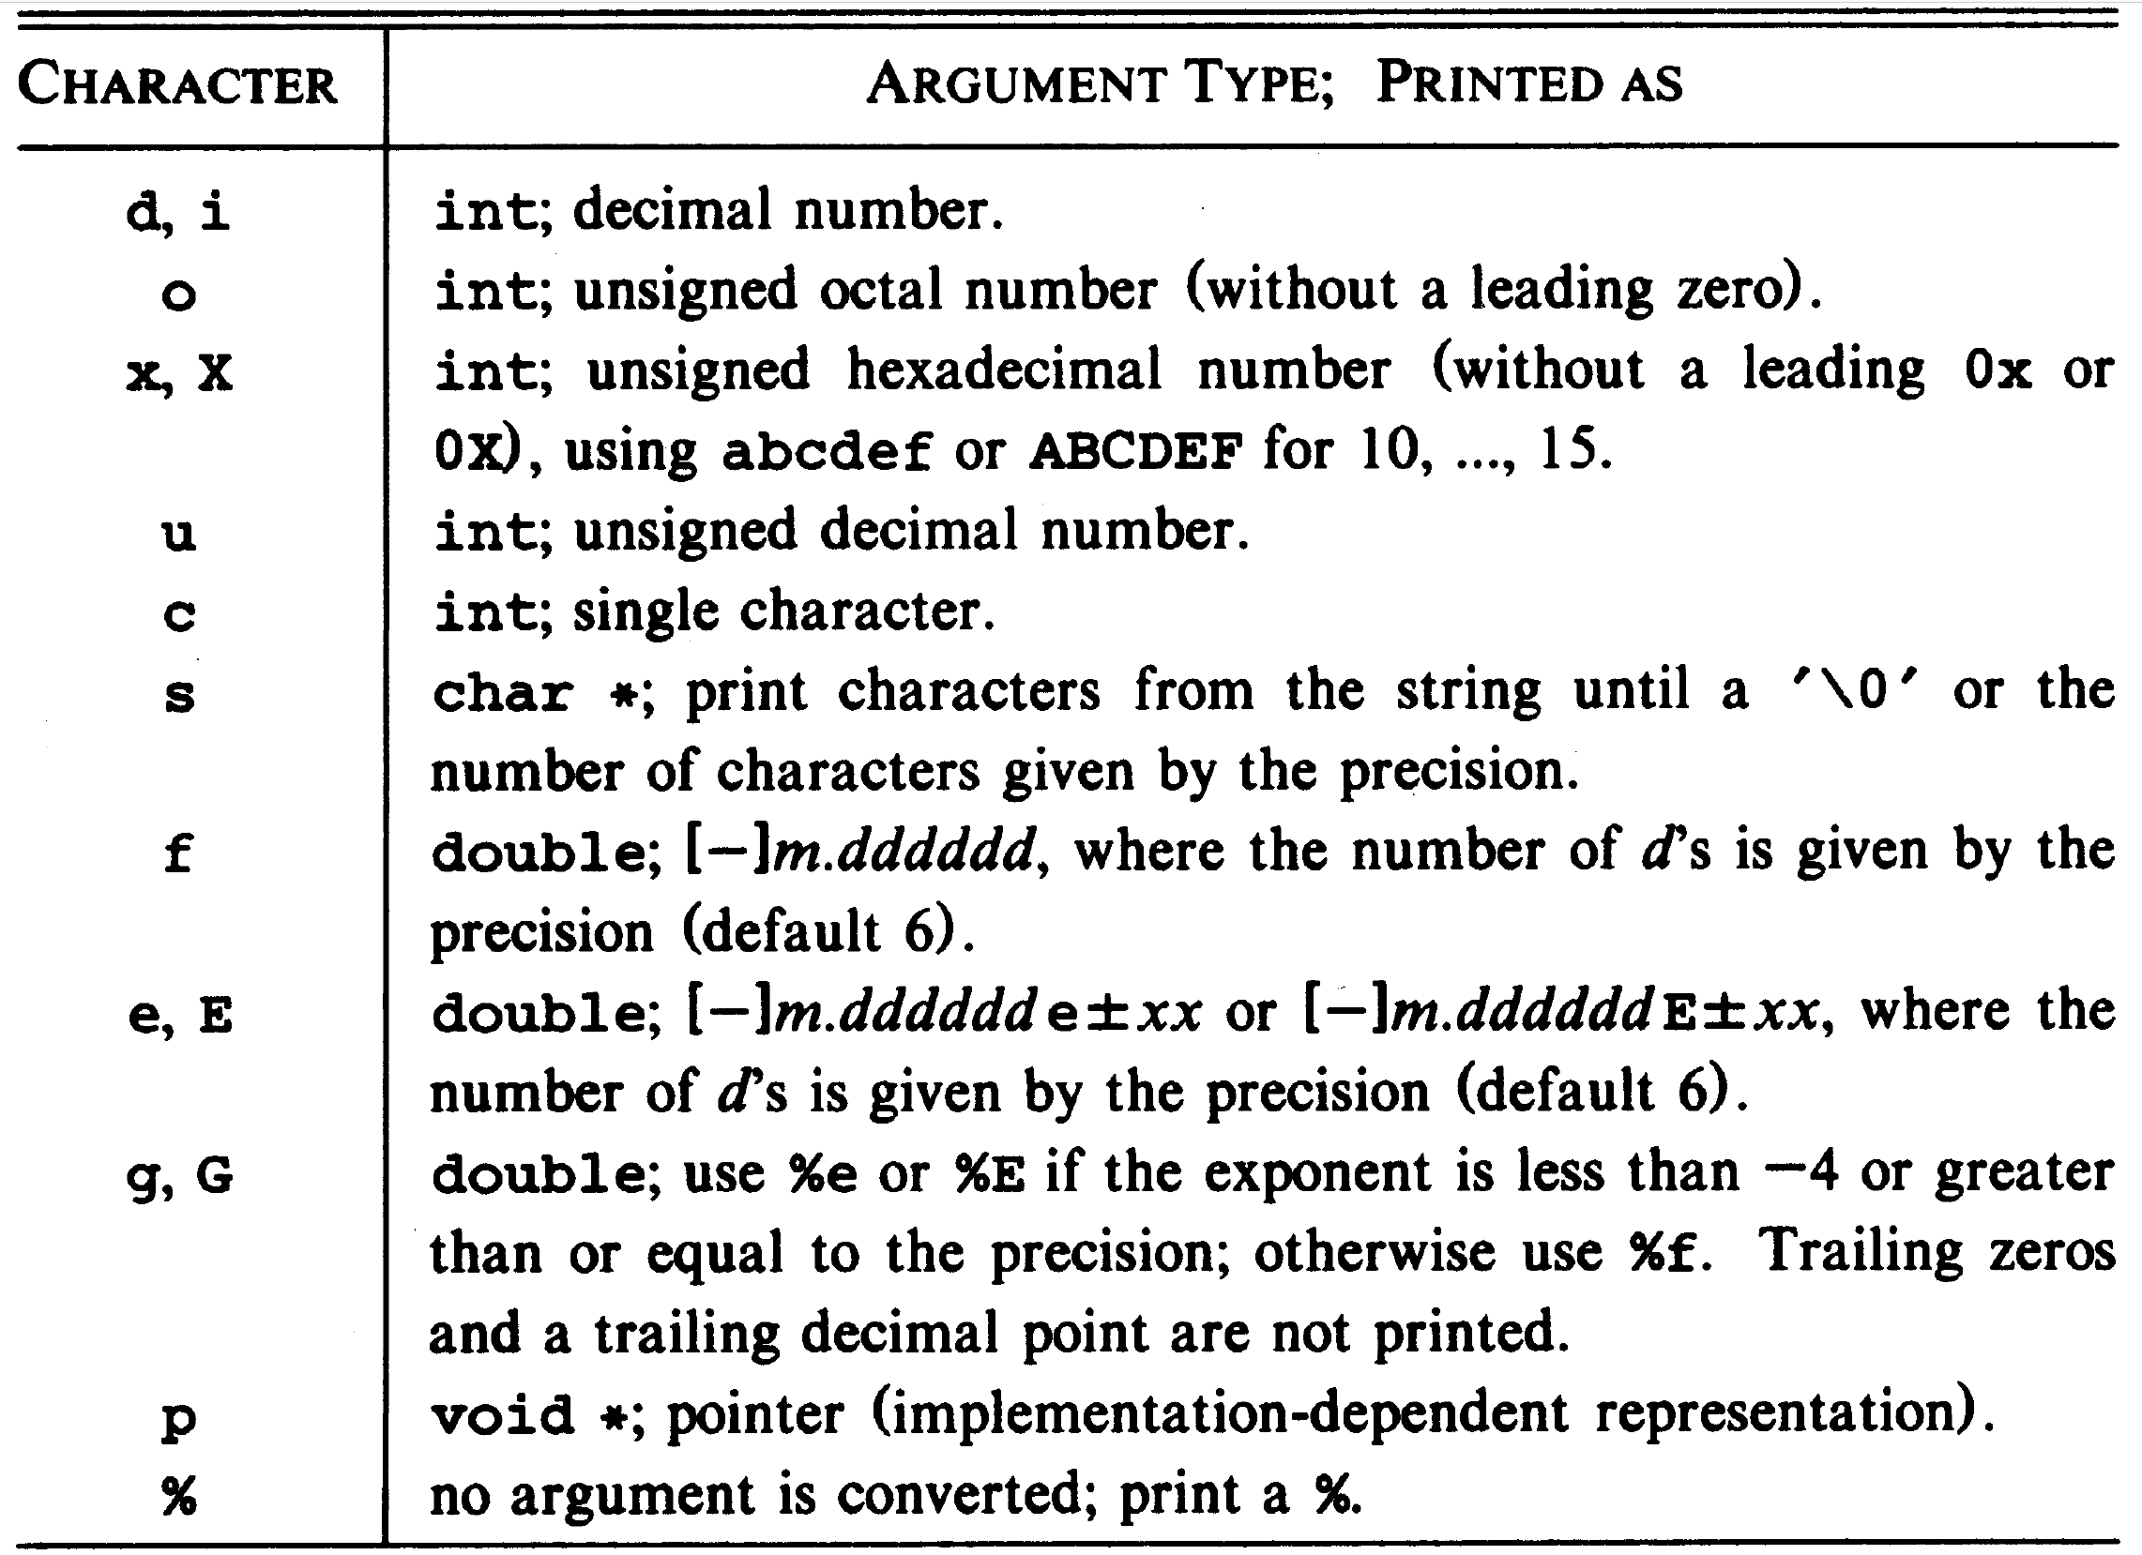
Formatted Output - printf

Slide 8
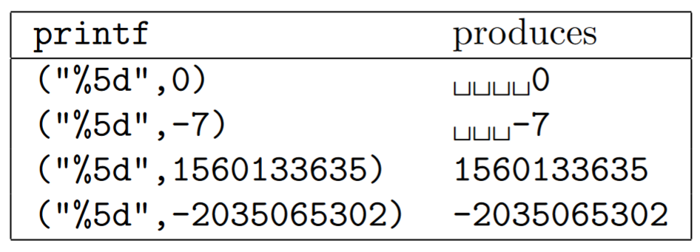
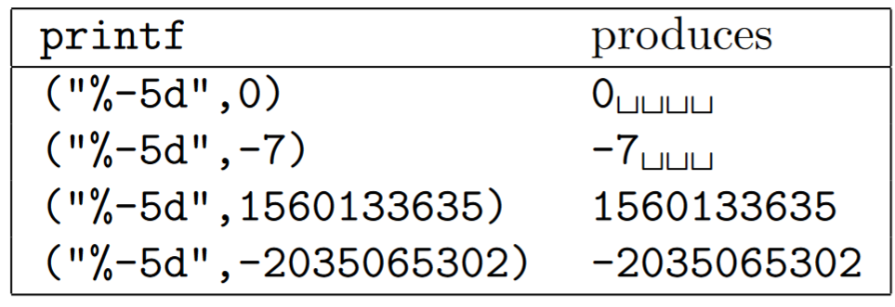
printf – Width Option

Slide 9
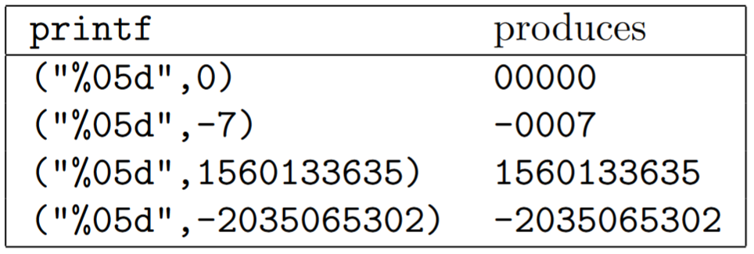
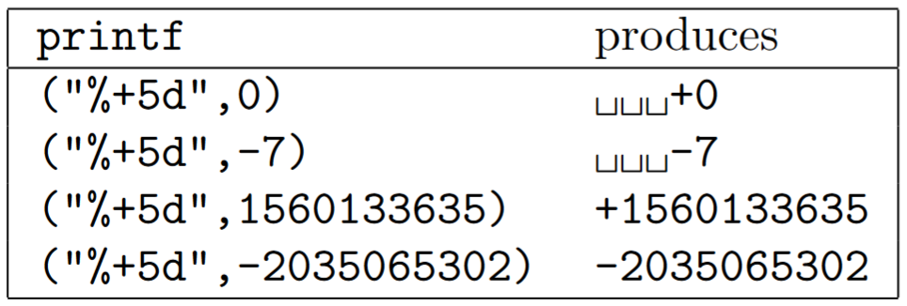
printf – Zero-Fill & Sign Option

Slide 10
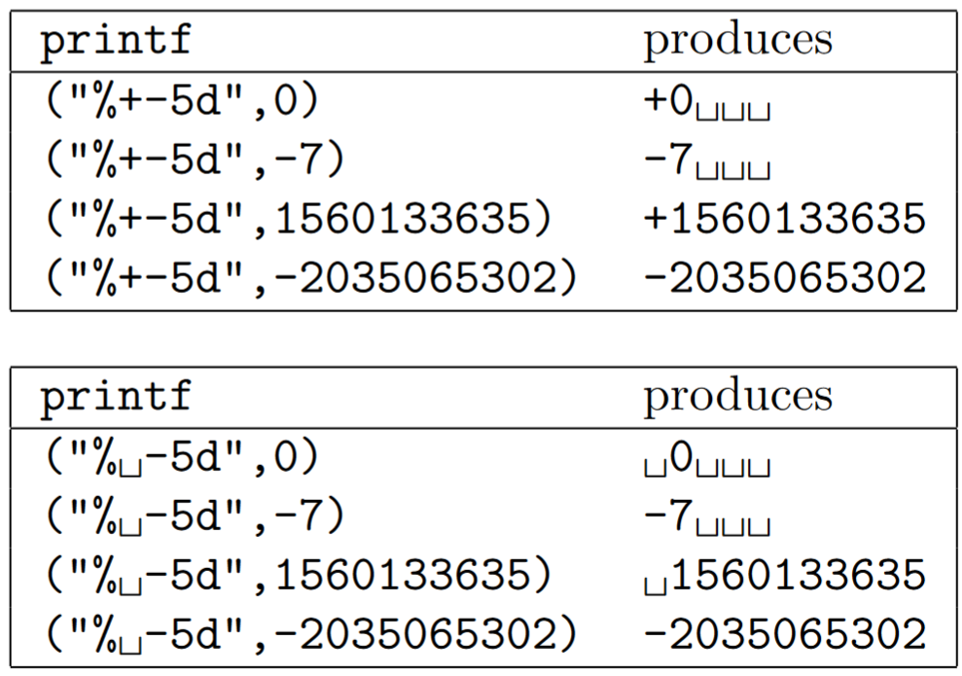
printf - Invisible Plus Sign

Slide 11
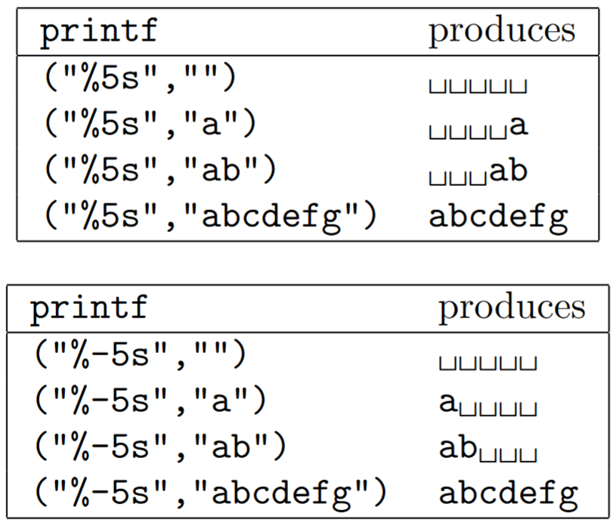
printf - Printing Strings

Slide 12
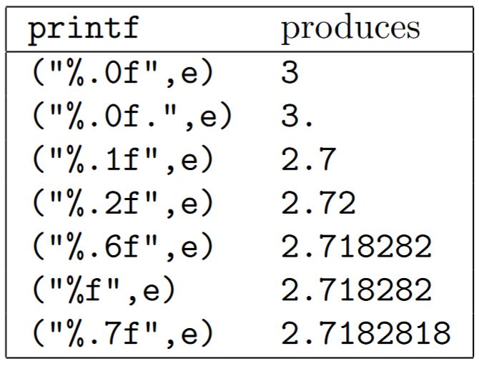
pritnf - Floating Point

Slide 13
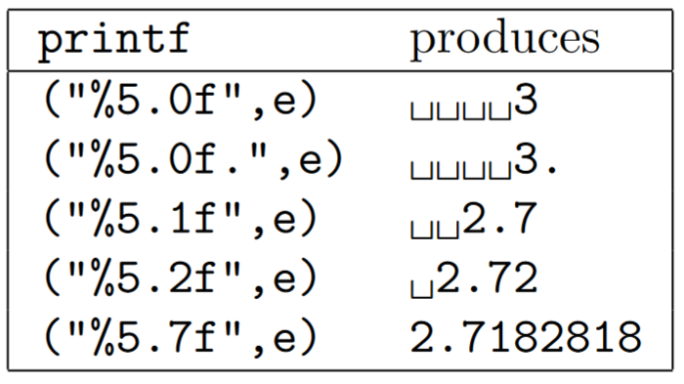
pritnf - Floating Point

Slide 14
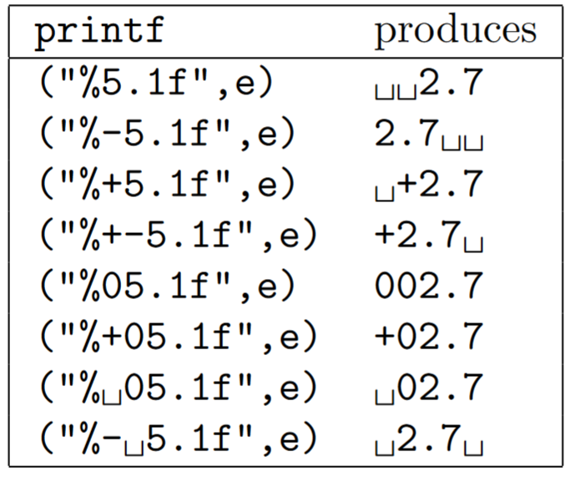
pritnf - Floating Point

Slide 15
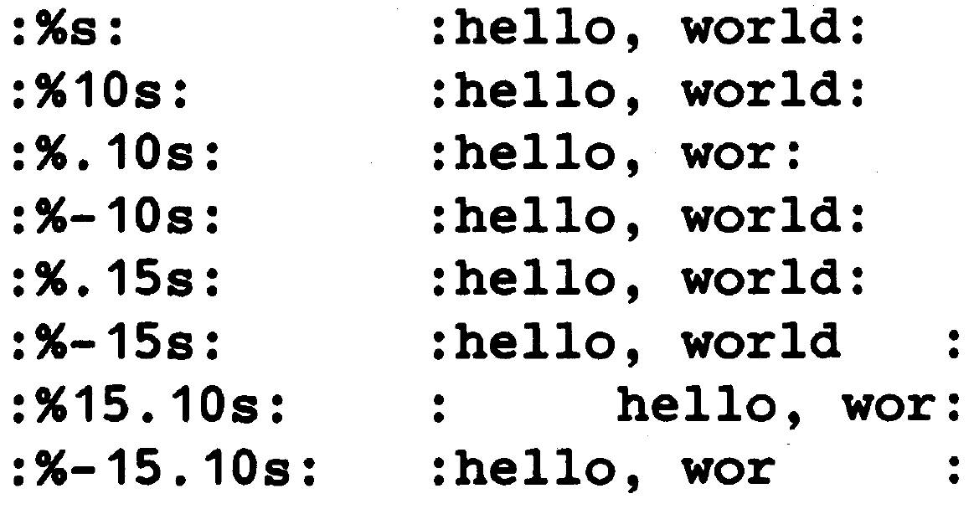
pritnf – Using Asterisk
A width or precision may be specified by *:
printf( “%.*s”, max, s)
Prints at most max characters from a string s

Slide 16
Variable-Length Argument Lists
Library <stdarg.h> provides the possibility of having a function with variable-length argument list:
The type va_list: is a pointer that refers to each unnamed argument in turn.
Macro va_start initializes a va_list type variable to point to the first unnamed argument.
va_arg function returns one argument and steps va_list type pointer to the next
va_end function cleans up at the end.

Slide 17
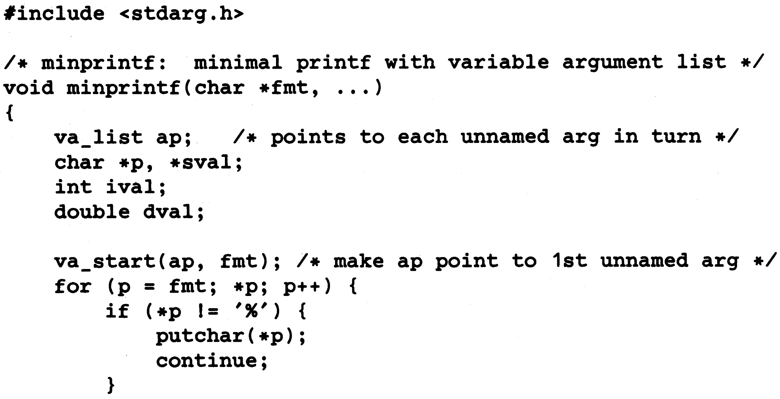
Variable-Length Argument Lists

Slide 18
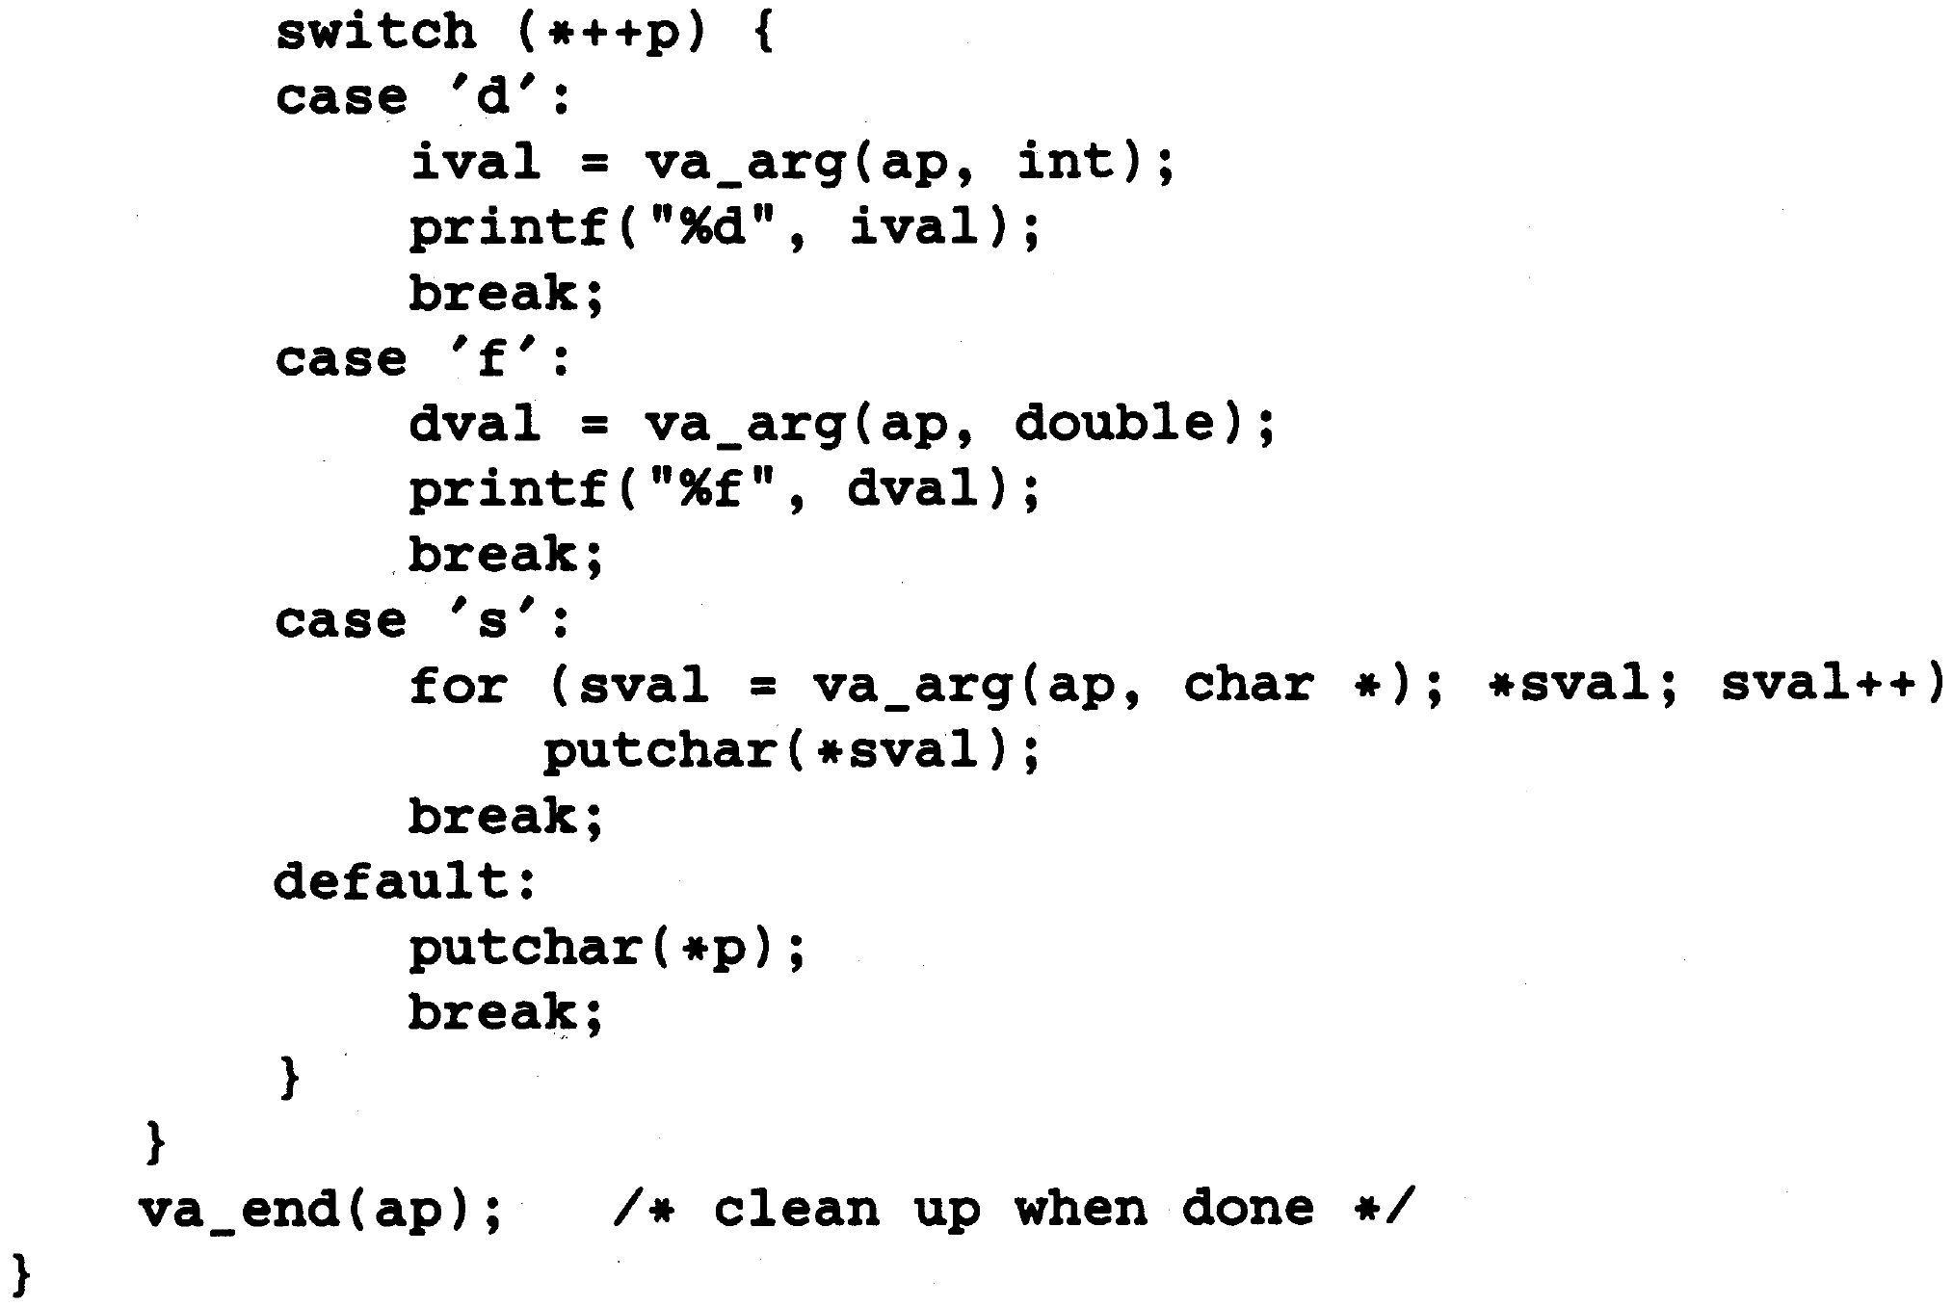
Variable-Length Argument Lists

Slide 19
Formatted Input: scanf
int scanf (char *format, … )
Reads characters from the standard input
Interpret them according to the specification in format
Other arguments must be pointers.
int sscanf (char *string, char *format, … )
Scans the string to the format specified in format and stores the resulting values through the rest of arguments.

Slide 20
Formatted Input: scanf
format contains:
Blanks or tabs which are ignored.
Ordinary characters (not %), which are expected to match in input stream.
Conversion specification: consisting of
character %,
an optional character *,
an optional number specifying a maximum field width,
an optional h (short), l (long), or L (very long), indicating the width of the target,
and a conversion character

Slide 21
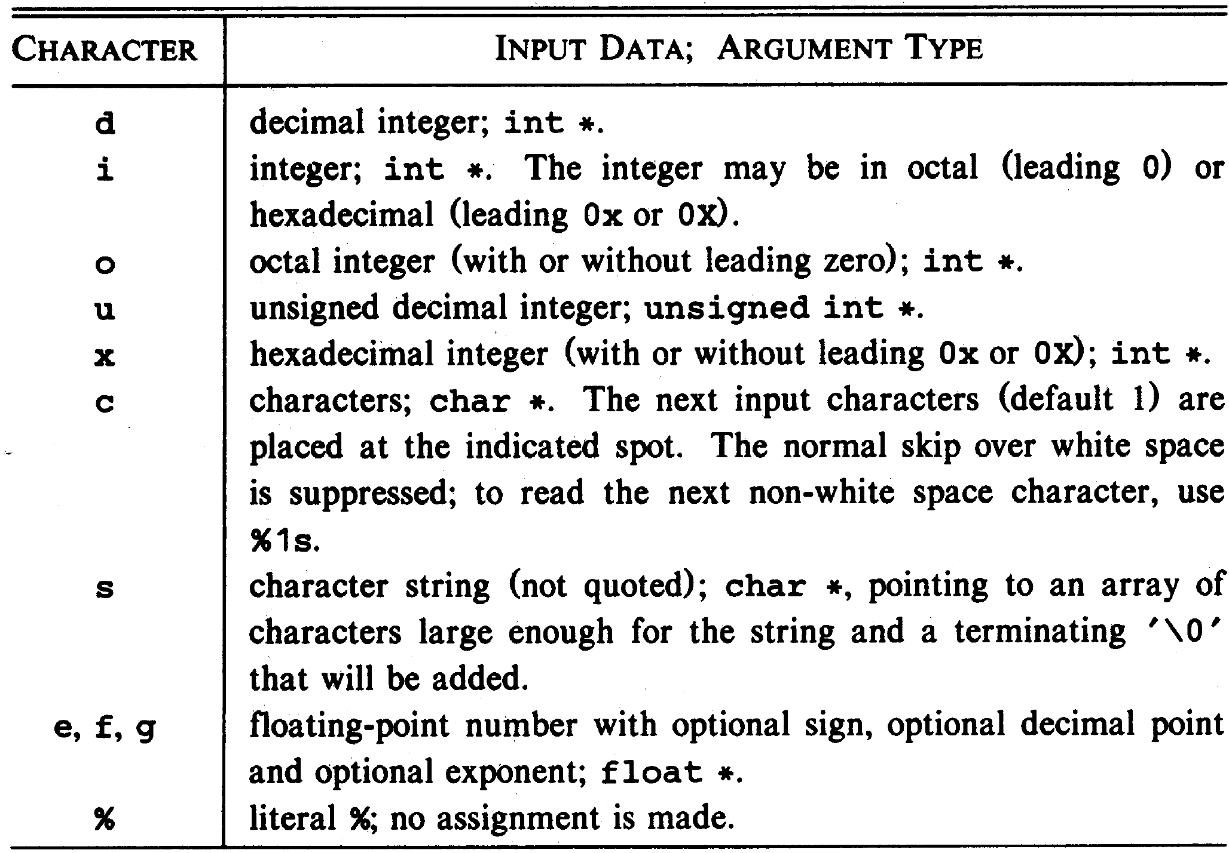
Formatted Input: scanf

Slide 22
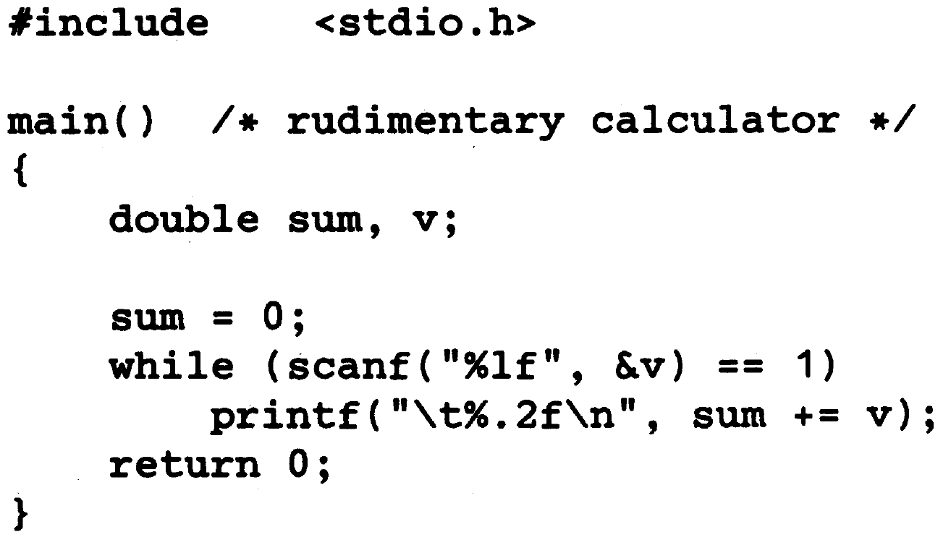
Example: Rudimentary Calculator

Slide 23
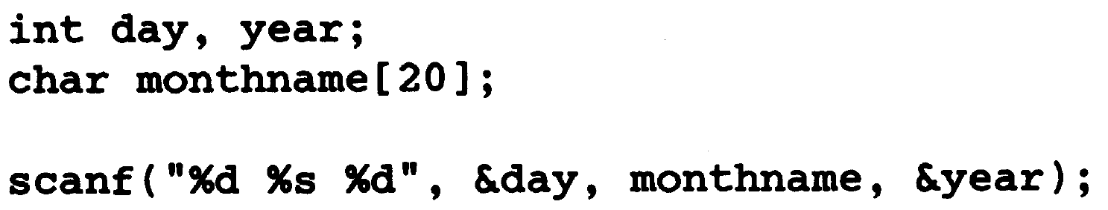
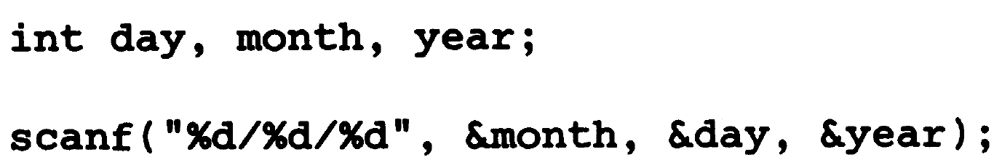
Example: Reading a Date

Slide 24
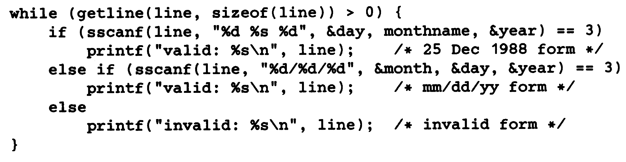
Example: Reading a Date

Slide 25
File Access
FILE *fp;
FILE *fopen (char *name, char *mode);
fp = fopen(name, mode);
mode can be
“r” (read mode),
“w” (write mode),
and “a” (append mode).
int getc (FILE *fp): get a character from file.
int putc (int c, FILE* fp) put a character into a file
int fscanf (FILE *fp, char *format, … )
int fprintf (FILE *fp, char *format, … )

